Slide 1
Healthcare analysis
Nikesh Raj
Kartikay Sharma
Reshma Waghmare
Udit Kulkarni
Kaif Shaikh
Omkar Kotgirwar

Slide 2
Insights
Total discharges are 14 Million.
Unique hospitals and overall hospitals are 604 & 6585 respectively.
Revenue generated of $474 Million.
Revenue peaked during first & second quarter of 2019.
MTD, YTD & QTD revenue are $30B, $60B & $30B respectively.
Comparable category generated 85% of the total revenue.
LA is the highest revenue generating state.

Slide 3
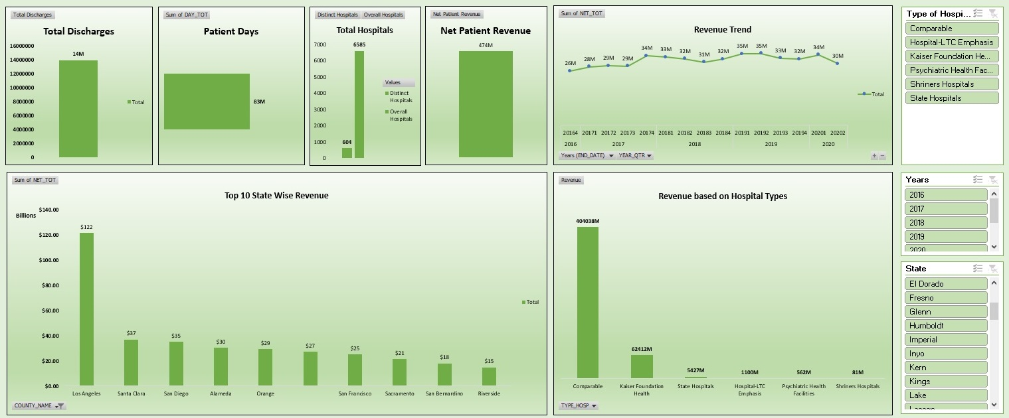
Excel dashboard

Slide 4
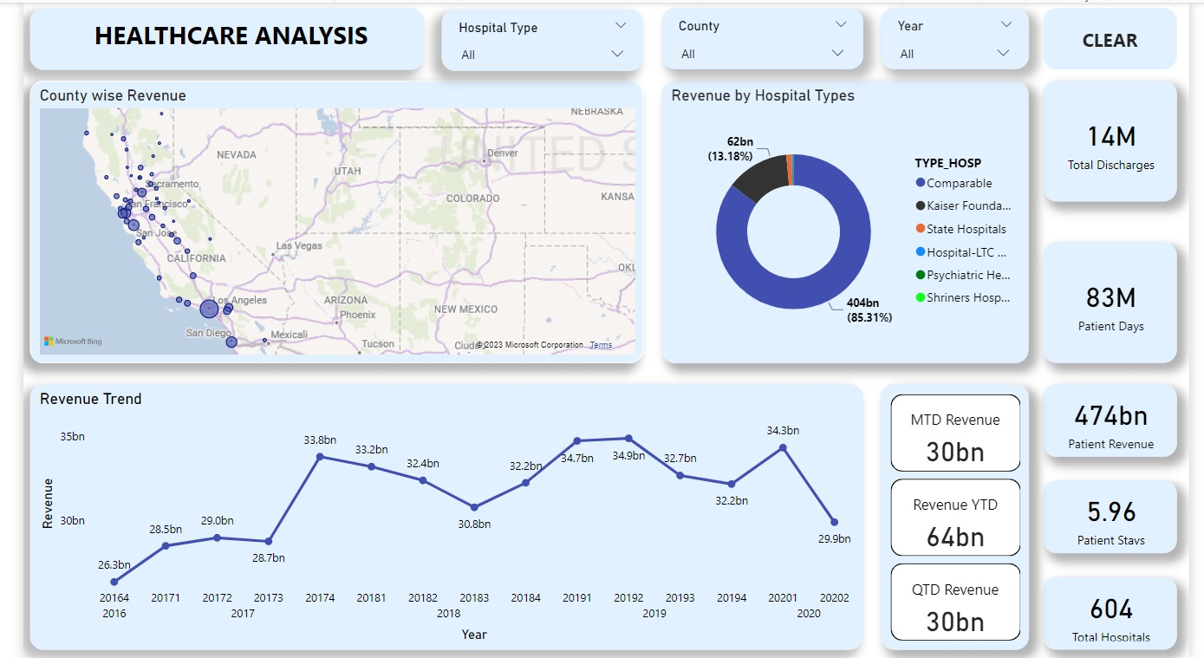
Power bi dashboard

Slide 5
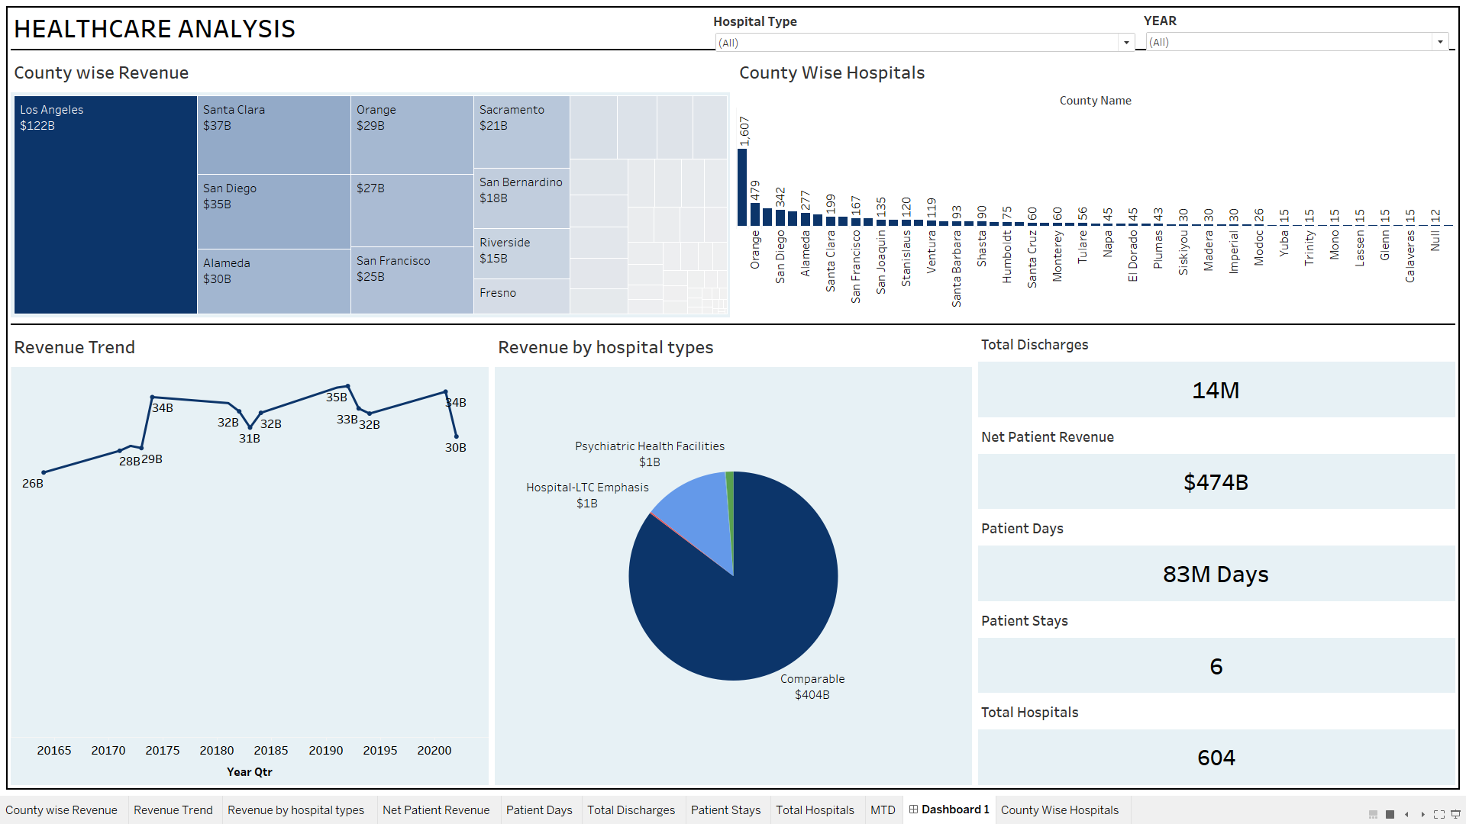
Tableau dashboard

Slide 6
SUMMARY
Healthcare analysis plays a major role in transforming the healthcare landscape by leveraging data-driven insights to enhance patient outcomes, optimize operational efficiency, and drive informed decision-making.
In this analysis, we delve into the landscape of the healthcare industry, exploring key trends, challenges, and opportunities. It covers various Key Performance Indexes (KPIs) such as total discharges, total hospitals, revenue trends, and much more.
Throughout the analysis, we aim to provide valuable insights into the future of healthcare, offering a perspective that combines the latest advancements with the enduring challenges faced by the industry.

